Slide 1
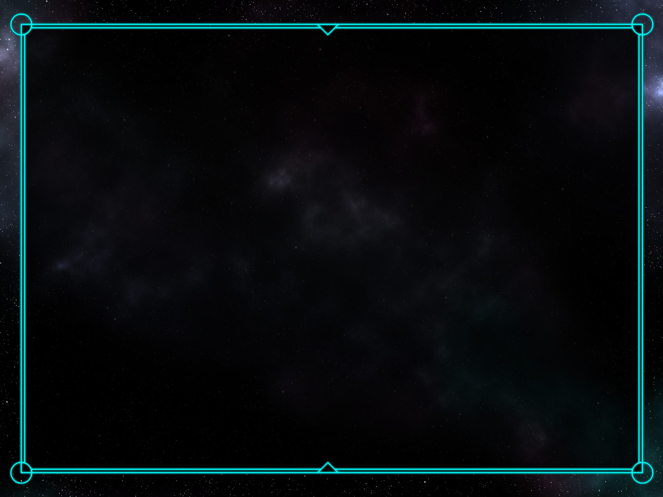
L6 Group-1 Pitch 4
Caitlin White, Connor Wilby, Jamie Chandler and Jordan Marks

Slide 2
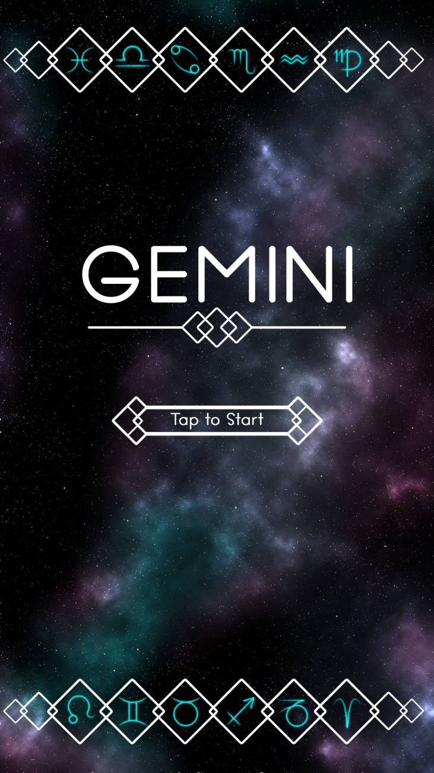
Our Brief
Mobile Platform
Potential for monetisation
Inclusion of smart depth
CW

Slide 3
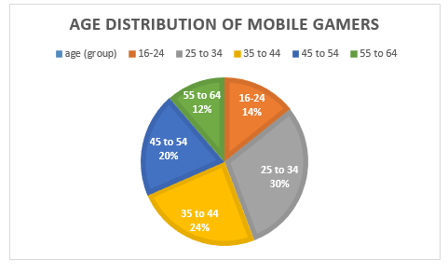
Demographic
Age: 25-44
Gender: Female
Source: http://www.realitymine.com/myth-busting-mobile-gaming-demographics/
JM

Slide 4
Psychographic
Emily
Favourite colour: Purple
Enjoys her own casual style
Enjoys shopping and reading in her spare time
Enjoys matching games
Times she spends each day on games: 2 hrs
Enjoys using social networks in the evening when she gets home to connect with her family and friends
JM

Slide 5
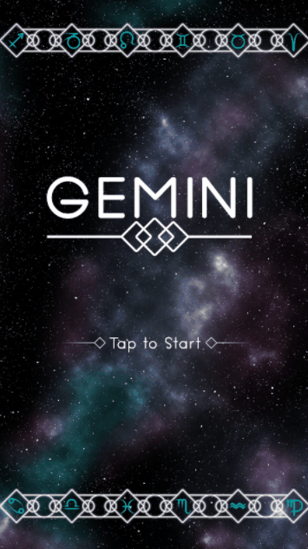
Platform and Genre
Platform: Mobile and Tablet
Genre: Hex based Puzzle
Duration: Up to 5 minutes
CJ

Slide 6
Game goal and Features
Creating an unbroken chain of hexes
Optimisation game
Hard Fun:
Accomplishment
Strategy
Clear Goal
CJ

Slide 7
The Game Loop
Level start
Move tiles
Complete level
Earn rewards
JM

Slide 8
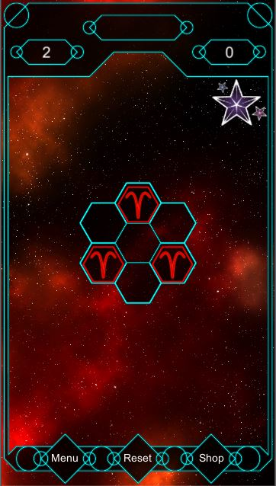
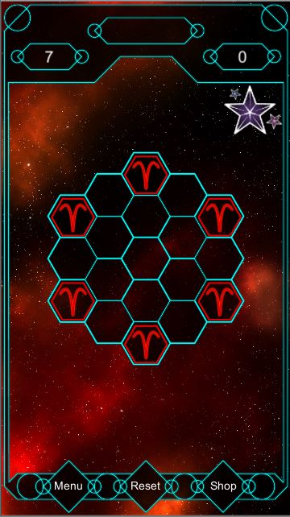
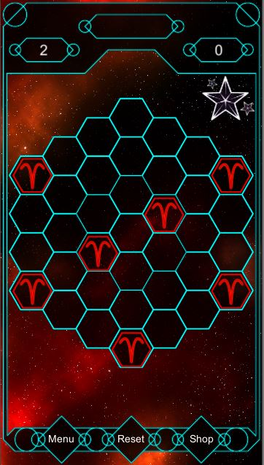
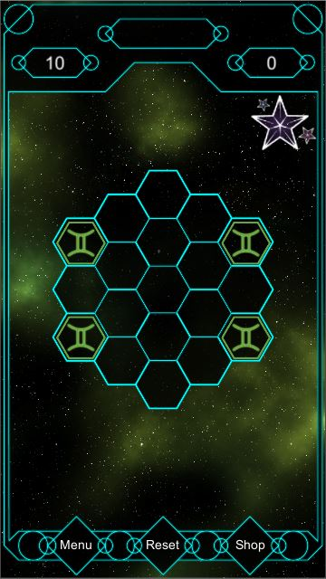
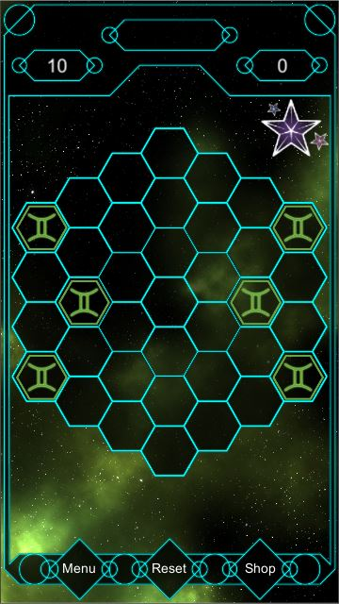
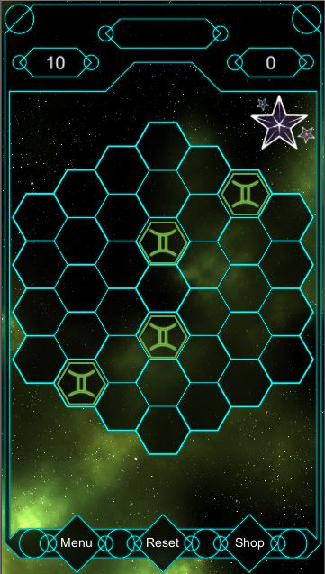
Current Levels in game
Aries
Gemini
JM

Slide 9
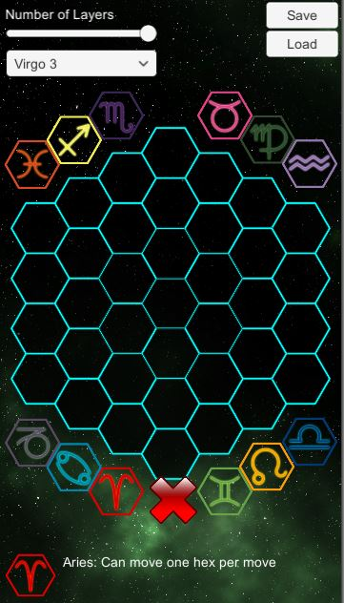
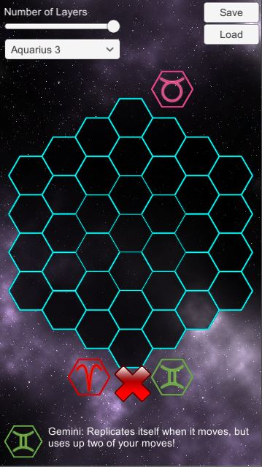
Level Editor
CJ

Slide 10
Tile Mechanics
Implemented:
Gemini: Replicate
Aries: Move one square
Taurus: Jump
Planned:
Rotate the tiles around it clockwise and anti-clockwise
Symmetrical movement/mirrored
Horizontal/vertical/diagonal movement
Edge of hex movement
CW

Slide 11
Currency & Power Ups
Stardust
Pricing from 99p to £59.99
Refill Lives/Stamina
Power-ups
Extra Moves
Place an extra symbol

Slide 12
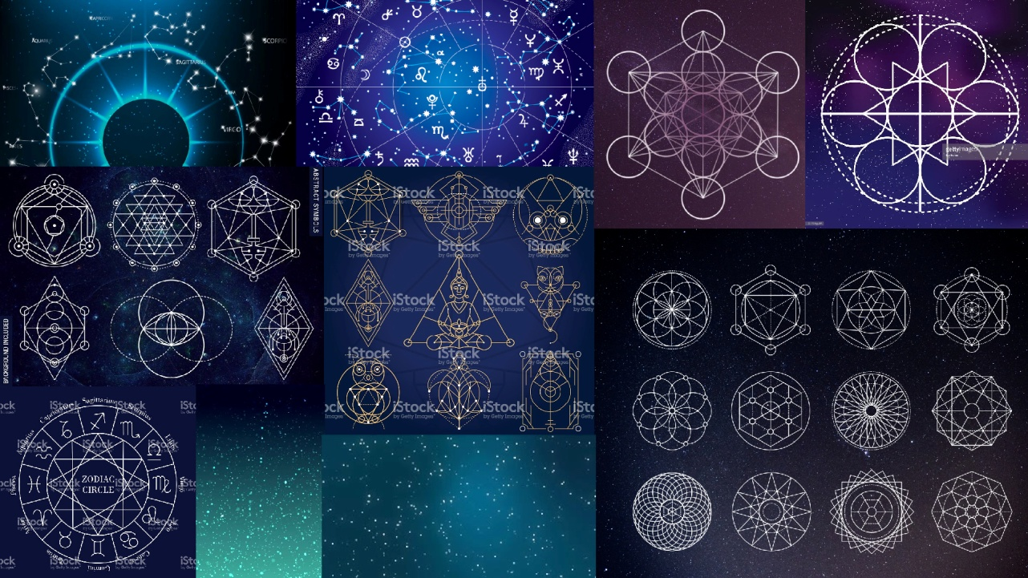
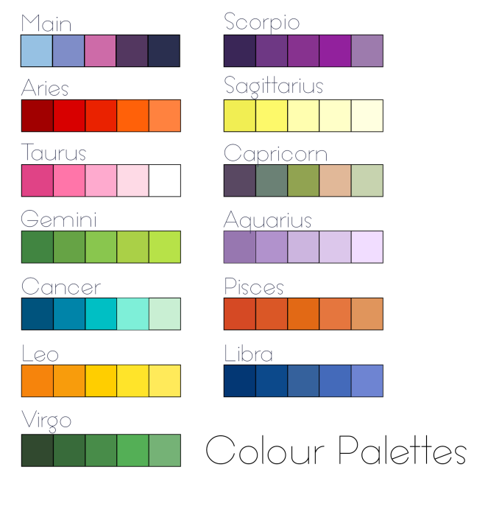
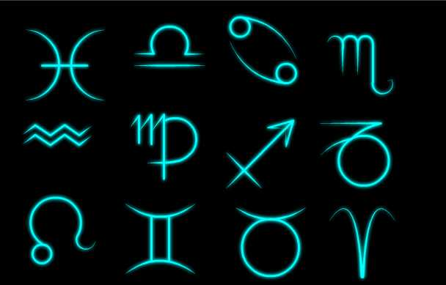

Artwork
CW

Slide 13
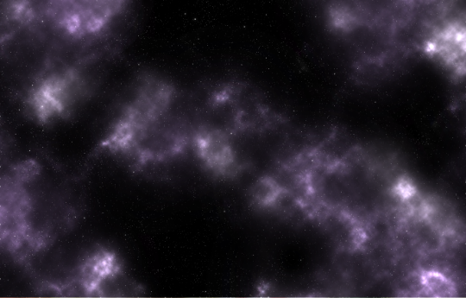
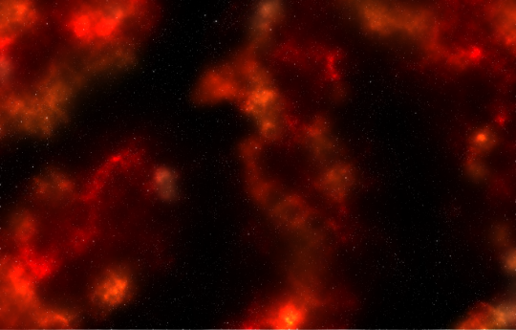

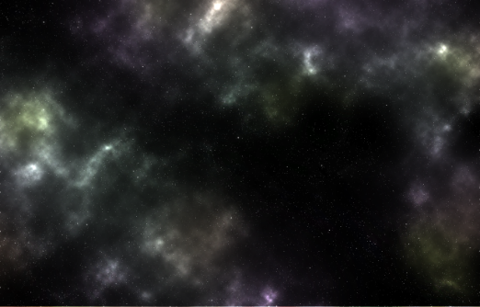
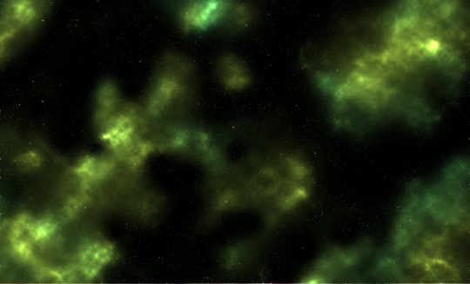
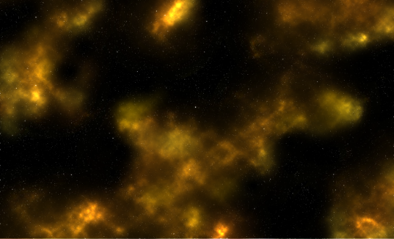
Artwork
CW

Slide 14
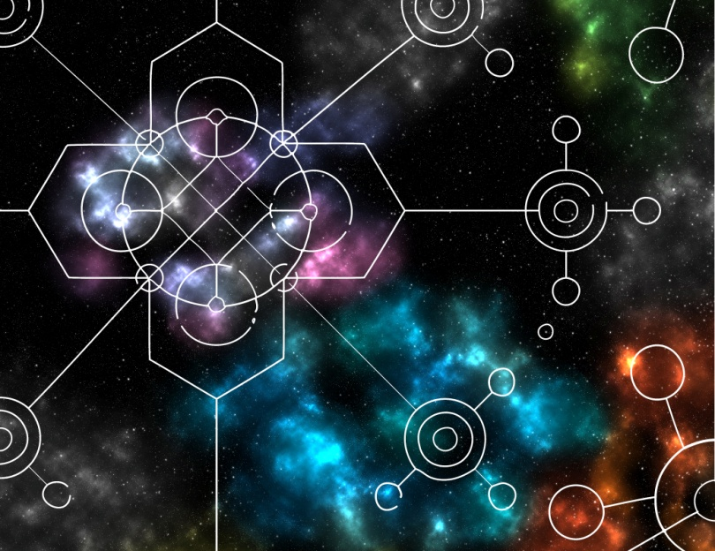
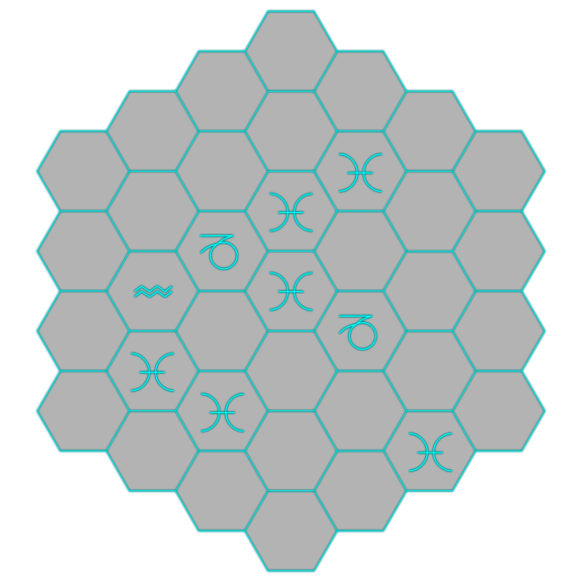
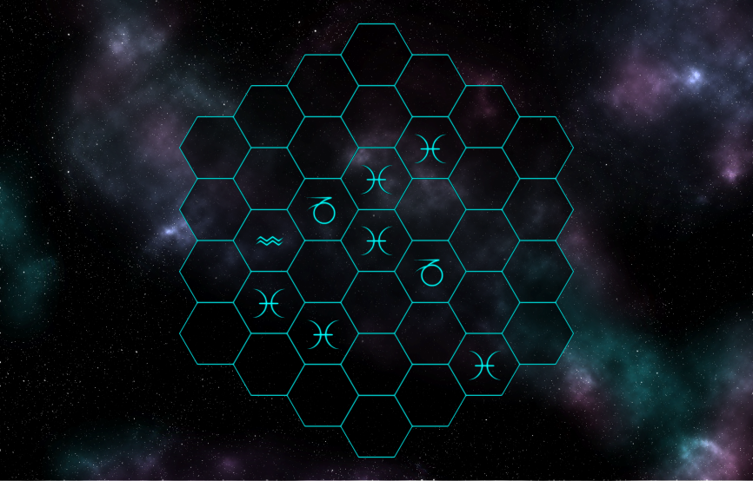
Artwork
CW

Slide 15
Playtesting & Usability Testing
Positive
Liked theme
Hex grid size sufficient
Negatives
Unclear what to do initially
No visual cue for completed level
JM

Slide 16
Strengths
Mechanics – easy to understand but hard to master
Suitable theme for target audience
Easy to play – buttons are good size to tap
JM

Slide 17
Weaknesses
Unclear what to do at first glance
Multiple tile mechanics – takes time to implement
Balancing
JM

Slide 18
Moving forward...
Further playtesting
Finalisation of characters, narrative and currency
Polishing of overworld
CJ

Slide 19
Questions?

